Slide 1

DataOrbit:
Healthcare Fraud
Detection
A proactive machine learning solution to flag high-risk providers.

Slide 2


Executive Summary
The Challenge
Our Objective
Healthcare fraud costs billions annually. Reactive rule-based systems fail to catch complex, evolving fraud schemes in real-time.
Develop a proactive Machine Learning solution to flag high-risk providers based on claims data while minimizing false positives.

Slide 3
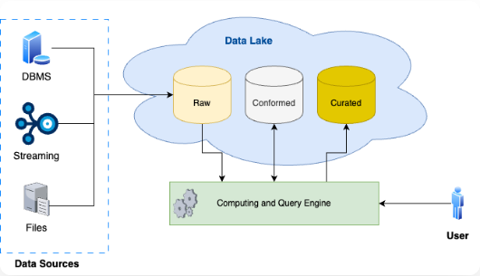
Data Architecture
CMS Source Data
• Beneficiary: Demographics, Chronic Conditions.
• Inpatient: Admissions, Diagnosis Codes, Costs.
• Outpatient: Visits, Procedures, Costs.
• Labels: Potential Fraud (Yes/No).

Slide 4




Feature Engineering
2. Financial Metrics
1. Volume Metrics
Total reimbursement amounts, deductibles, and average claim cost per provider.
Total claim counts, unique beneficiaries, and daily claim averages.
4. Data Aggregation
3. Network Metrics
Transactional claim data was aggregated to create a "Behavioral Fingerprint" for each provider.
Patient churn, attending physician links, and diagnosis diversity.

Slide 5
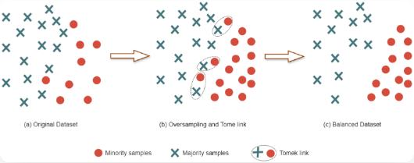
Methodology: Handling Imbalance
The 9.3% Problem
Only ~9% of providers are flagged as fraudulent. Standard models ignore the minority class.
The Solution: SMOTE
We used Synthetic Minority Over-sampling Technique (SMOTE) on the training data to create synthetic examples of fraud, allowing the model to learn robust decision boundaries.

Slide 6
Model Algorithm Comparison
We tested four distinct algorithms on the test set. ROC-AUC was the primary metric for discriminative ability.
Model | ROC-AUC Score | Status
Logistic Regression | 0.9208 | Baseline
Decision Tree | 0.7209 | Underperforming
Random Forest | 0.9204 | Selected (Best Balance)
Gradient Boosting | 0.9329 | Highest Score (High Complexity)
Note: While Gradient Boosting had a slightly higher AUC, Random Forest was selected for its robustness, parallelization capabilities, and lower risk of overfitting on noisy medical data.

Slide 7
Detailed Evaluation (RF vs LR)
Metric | Logistic Regression | Random Forest | Interpretation
Precision | 0.40 | 0.51 | RF generates significantly fewer false alarms.
Recall | 0.85 | 0.71 | LR catches more, but at the cost of accuracy.
F1-Score | 0.54 | 0.60 | RF offers the best balance of precision and recall.
ROC-AUC | 0.92 | 0.92 | Both models rank risk effectively.

Slide 8

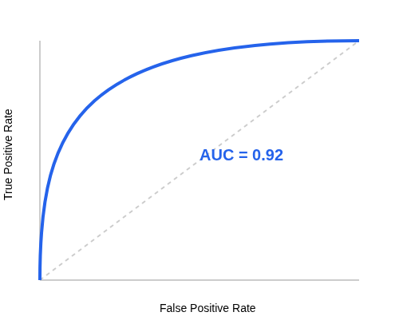
ROC Curve – Random Forest
Strong Separation
The Random Forest model achieves a strong ROC-AUC of 0.92.
This indicates a high ability to distinguish between fraud and legitimate providers across various threshold settings, significantly better than random guessing.

Slide 9
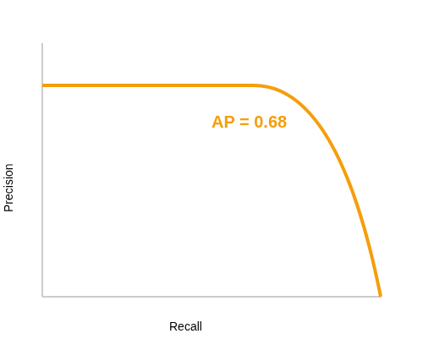
Precision-Recall Curve
Why PR Matters
Due to the class imbalance (only ~9% fraud), accuracy is misleading. The PR Curve shows the trade-off between capturing fraud (Recall) and being right when we do (Precision).
RF maintains high precision even at moderate recall levels.

Slide 10
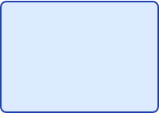



Confusion Matrix (Test Set)
Key Takeaways
Predicted: NO
Predicted: YES
Actual: NO
• 1141 Correct Rejections (TN): The vast majority of legitimate providers are correctly cleared.
1141
85
TRUE NEGATIVE
FALSE POSITIVE
• 90 Fraudsters Caught (TP): The model successfully identified 90 high-risk entities.
Actual: YES
• 85 False Alarms (FP): A manageable workload for investigators.
37
90
FALSE NEGATIVE
TRUE POSITIVE
• 37 Missed (FN): 'Quiet' fraudsters that mimic normal behavior patterns closely.

Slide 11
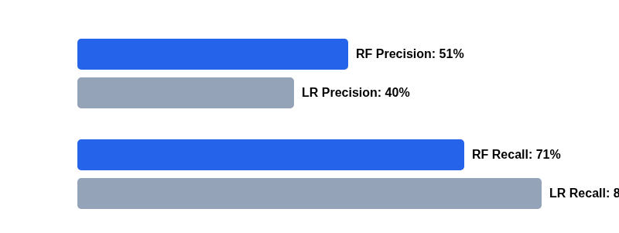
Precision vs. Recall Trade-off
Random Forest (Blue) sacrifices some recall to significantly improve precision, reducing wasted auditor time.

Slide 12




Why Random Forest?
1. Non-Linearity
2. Robust to Noise
Fraud patterns are rarely linear. RF captures complex interactions between claim volume, beneficiary demographics, and costs.
By averaging multiple decision trees, RF reduces the variance and risk of overfitting inherent in single Decision Trees.
3. Interpretability
4. Operational Efficiency
Feature Importance scores allow us to explain why a provider was flagged (e.g., "High Claim Count").
Higher precision means investigators spend less time chasing false leads compared to Logistic Regression.

Slide 13

Operational Conclusion
Random Forest is the recommended model.
By flagging providers based on behavioral fingerprints rather than simple rules, DataOrbit allows the SIU (Special Investigation Unit) to move from reactive to proactive fraud detection.
Next Steps:
• Deploy model to batch process monthly claims.
• Investigate the top 50 highest-risk providers immediately.
• Refine feature engineering to capture "quiet" fraudsters (False Negatives).

Slide 14
Questions?
DataOrbit Project Review

Slide 15


Image Sources
https://miro.medium.com/v2/resize:fit:666/1*vh1hFhWU0w0CzCiA64Xy3A.png
Source: medium.com
https://pub.mdpi-res.com/mathematics/mathematics-12-01709/article_deploy/html/images/mathematics-12-01709-g001.png?1718092992
Source: www.mdpi.com

